Slide 1
The Impact of Social Media on Workplace Productivity
By Oliver Leng

Slide 2
Business Questions
Goal: Use our data to inform the developer of the best productivity features tailored to user behaviour.
The key questions driving our analysis:
What digital habits are most associated with low productivity?
What features should be prioritized to best improve user productivity?
Do user’s who use focus apps have an improvement in productivity? If so what is the average improvement and how can this app do better?
Is there a difference in patterns across age groups in how digital habits affect productivity? Should the app use different strategies for the age groups?

Slide 3
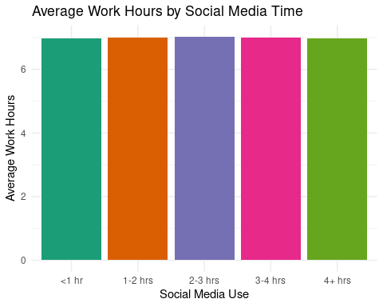
Social Media Time vs Work Hours
This visualization shows that there is no significant change in average work hours across different levels of daily social media usage.
This suggests that while people may spend varying amounts of time on social media, it does not appear to reduce the total hours they work each day. However, this does not rule out an effect on productivity—social media might be impacting focus or efficiency during work hours rather than total time worked.

Slide 4
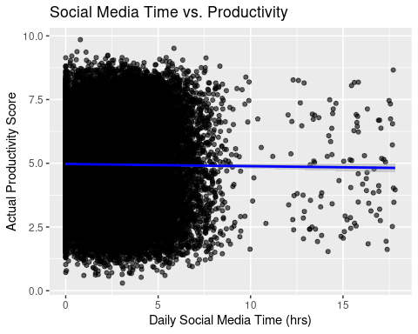
Social Media Time Vs Productivity
This chart shows a weak negative correlation between daily social media time and productivity scores.
While increased social media use is generally associated with slightly lower productivity, the wide spread of data points suggests high individual variation. This implies that some users remain productive despite high social media usage, while others see a more noticeable decline—indicating that social media’s impact on productivity is not uniform across all individuals.

Slide 5
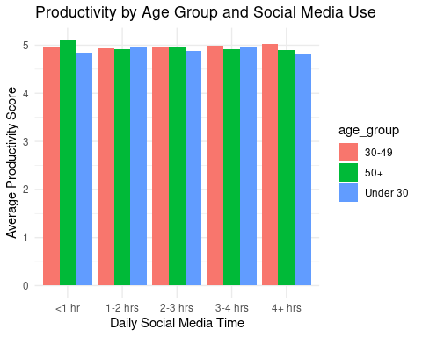
Productivity by Age Group and Social Media Time
Productivity scores appear relatively stable across age groups for each social media use range, suggesting that age is not a strong moderator in the relationship between social media use and productivity.

Slide 6
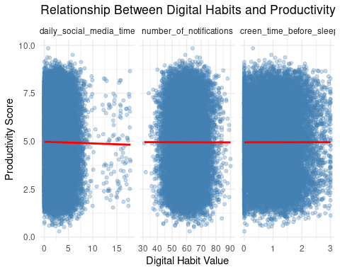
Relationship Between Digital Habits and Productivity
Among all the digital habits analyzed, daily social media time shows the strongest negative correlation with productivity.
This suggests that the startup app should prioritize features that reduce social media usage, such as usage limits, activity tracking, or blocking access during work hours, as this area offers the greatest opportunity to boost user productivity.

Slide 7

Alternative Focus Apps
Data shows that users who actively use other focus apps experience a slight improvement in productivity and digital habits. While the effect is modest, this indicates real potential for our new app to:
Outperform existing solutions
Leverage more personalized, data-driven features
Deliver greater productivity gains by addressing current gaps
This validates the market demand and opportunity for innovation.

Slide 8
Recommendations
Prioritise social media management features – social media time had the largest impact on productivity and therefore it would be the best thing to implement.
Personalisation over age segmentation – age does not have a large impact on habits so focus more on customisable features because there is a large variety in user behaviour and habits.
Boost impact beyond other focus apps – add features to encourage accountability such as streaks and goals.
Although screen time and notifications do not strongly correlate with productivity in the dataset, this presents a design opportunity rather than a limitation. We could implement a new feature to restrict phone access and replace the lock screen with a motivational message or reminder of goals. This is to make sure the user is focused on greater productivity, not just alternatives to their phone.

